Slide 1

Advanced Topics in Networking: Special Topics in Internet of Things
Lecture 2: Ubiquitous computing, projects and wireless basics
Ambuj Varshney
ambujv@nus.edu.sg, http://ambuj.se
Notes:
++ Thank you for inviting me to give this talk
++ In this talk, I will present a pathway that can enable us to make wireless embedded systems ubiquitous. I will describe my previous research efforts that tackle the critical challenges that limit the growth of wireless embedded systems. These are related to the growing energy asymmetry that exists between sensing, computation and communication blocks on these platforms.
++ Finally, I will conclude my talk by covering the research agenda that I would like to work on as a faculty member.

Slide 2
Roadmap of the presentation
Administrative and other information
Ubiquitous computing visions
Picking problems for the project?
Reading summary for submission
Notes:
Here is the roadmap of the major topics that I am going to cover during the presentation. We have already covered the exponential growth of the internet of things; next, I will talk about the critical energy challenge that can severely hinder this massive growth and preventing us from realising this immense economic value enabled by the IoT.

Slide 3
General course information
Course code: 6204, Wednesdays – 2 pm to 4 pm
Course website: Weiser page, Credits: 4
Office hours: COM3 - #2 – 25, Friday : 4 – 6 pm (by appointment)
Notes:
++ We may all have heard of the term Internet of Things. So how are these wireless embedded systems related to the Internet of Things: Today, IoT includes a broad class of devices, including powerful platforms such as smartphones. However, it also includes more resource-constrained devices and what we call Wireless Embedded Systems, and in fact, I consider it to be one of the essential parts of the IoT ecosystem.
++ These are platforms equipped with a radio transceiver, sensor, microcontroller, and some form of energy storage. These platforms also often form a network, and sensor network as it is called has been an active area of research for the past two decades.
++ The research community has also developed wireless embedded platforms which we may know about, and these include: CMUCAM, which is an image sensor platform developed at Carnegie Mellon University, or Permamote is long life sensor platform from the lab I am associated with at UC Berkeley or Lorea which is a long-range backscatter platform that I had developed as part of my doctoral dissertation at Uppsala University. All of these are an example of Wireless Embedded Systems.

Slide 4
General course information
This is graduate level course (mostly PhD students)
No exam in this course!
Weekly (or bi-weekly sometimes) paper summaries
Class presentations of research papers
Small class project (Individually or can be done in small team)
Some lectures may be held over zoom; October [Travelling]
Notes:
++ We may all have heard of the term Internet of Things. So how are these wireless embedded systems related to the Internet of Things: Today, IoT includes a broad class of devices, including powerful platforms such as smartphones. However, it also includes more resource-constrained devices and what we call Wireless Embedded Systems, and in fact, I consider it to be one of the essential parts of the IoT ecosystem.
++ These are platforms equipped with a radio transceiver, sensor, microcontroller, and some form of energy storage. These platforms also often form a network, and sensor network as it is called has been an active area of research for the past two decades.
++ The research community has also developed wireless embedded platforms which we may know about, and these include: CMUCAM, which is an image sensor platform developed at Carnegie Mellon University, or Permamote is long life sensor platform from the lab I am associated with at UC Berkeley or Lorea which is a long-range backscatter platform that I had developed as part of my doctoral dissertation at Uppsala University. All of these are an example of Wireless Embedded Systems.

Slide 5
General course information
Structure of the course:
Initial phase (led by instructor): Foundations of internet of things
Middle phase (led by the students) : student presentations, drafting of the project problem statement, invited lectures from academia and industry
Last phase (led by students): project execution and presentation
Initial phase: End of september
Middle/Last phase: October onwards
Project problem statement ready by the beginning of October
Notes:
++ We may all have heard of the term Internet of Things. So how are these wireless embedded systems related to the Internet of Things: Today, IoT includes a broad class of devices, including powerful platforms such as smartphones. However, it also includes more resource-constrained devices and what we call Wireless Embedded Systems, and in fact, I consider it to be one of the essential parts of the IoT ecosystem.
++ These are platforms equipped with a radio transceiver, sensor, microcontroller, and some form of energy storage. These platforms also often form a network, and sensor network as it is called has been an active area of research for the past two decades.
++ The research community has also developed wireless embedded platforms which we may know about, and these include: CMUCAM, which is an image sensor platform developed at Carnegie Mellon University, or Permamote is long life sensor platform from the lab I am associated with at UC Berkeley or Lorea which is a long-range backscatter platform that I had developed as part of my doctoral dissertation at Uppsala University. All of these are an example of Wireless Embedded Systems.

Slide 6
Research topics for student led seminars
Research topics that could be of interest for discussion:
Vision papers [This week]
Classic sensor network and recent IoT deployments
Low-power, Long-range wireless networks [E.g. LoRa]
Wireless standards for IoT [ZigBee, BLE, WiFi]
Backscatter and energy harvesting
Other emerging wireless technologies for IoT [LiFi, Acoustic]
Security and operating systems for IoT
Novel applications
Others?
Notes:
++ We may all have heard of the term Internet of Things. So how are these wireless embedded systems related to the Internet of Things: Today, IoT includes a broad class of devices, including powerful platforms such as smartphones. However, it also includes more resource-constrained devices and what we call Wireless Embedded Systems, and in fact, I consider it to be one of the essential parts of the IoT ecosystem.
++ These are platforms equipped with a radio transceiver, sensor, microcontroller, and some form of energy storage. These platforms also often form a network, and sensor network as it is called has been an active area of research for the past two decades.
++ The research community has also developed wireless embedded platforms which we may know about, and these include: CMUCAM, which is an image sensor platform developed at Carnegie Mellon University, or Permamote is long life sensor platform from the lab I am associated with at UC Berkeley or Lorea which is a long-range backscatter platform that I had developed as part of my doctoral dissertation at Uppsala University. All of these are an example of Wireless Embedded Systems.

Slide 7
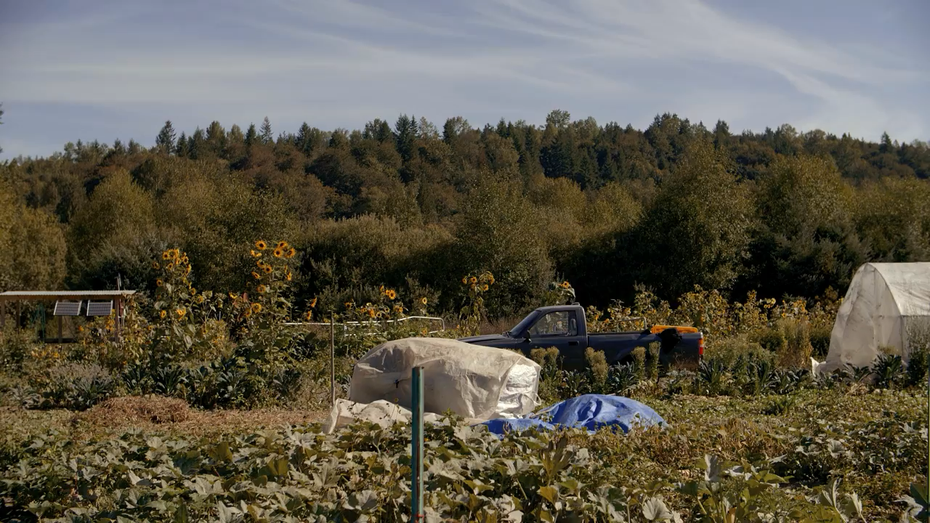
Example [Applications and deployments]: Farmbeats
Notes:
++ We may all have heard of the term Internet of Things. So how are these wireless embedded systems related to the Internet of Things: Today, IoT includes a broad class of devices, including powerful platforms such as smartphones. However, it also includes more resource-constrained devices and what we call Wireless Embedded Systems, and in fact, I consider it to be one of the essential parts of the IoT ecosystem.
++ These are platforms equipped with a radio transceiver, sensor, microcontroller, and some form of energy storage. These platforms also often form a network, and sensor network as it is called has been an active area of research for the past two decades.
++ The research community has also developed wireless embedded platforms which we may know about, and these include: CMUCAM, which is an image sensor platform developed at Carnegie Mellon University, or Permamote is long life sensor platform from the lab I am associated with at UC Berkeley or Lorea which is a long-range backscatter platform that I had developed as part of my doctoral dissertation at Uppsala University. All of these are an example of Wireless Embedded Systems.

Slide 8
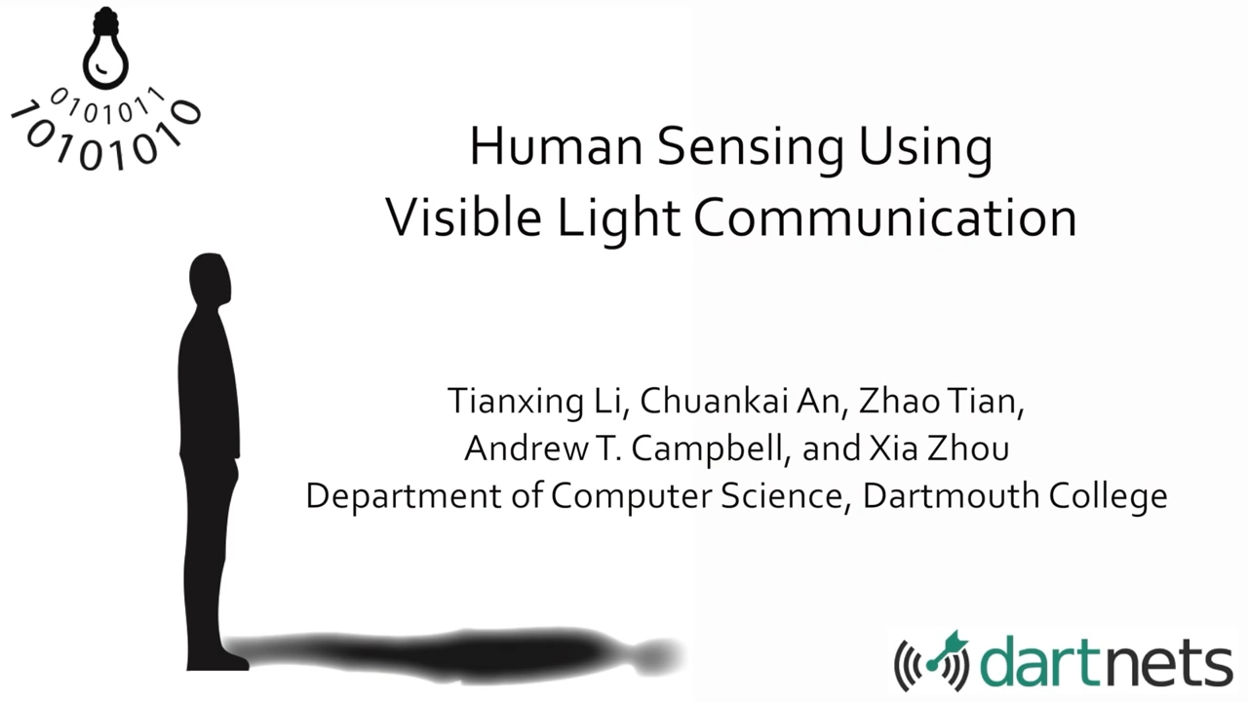
Example [Emerging communication]: Light sensing
Notes:
++ We may all have heard of the term Internet of Things. So how are these wireless embedded systems related to the Internet of Things: Today, IoT includes a broad class of devices, including powerful platforms such as smartphones. However, it also includes more resource-constrained devices and what we call Wireless Embedded Systems, and in fact, I consider it to be one of the essential parts of the IoT ecosystem.
++ These are platforms equipped with a radio transceiver, sensor, microcontroller, and some form of energy storage. These platforms also often form a network, and sensor network as it is called has been an active area of research for the past two decades.
++ The research community has also developed wireless embedded platforms which we may know about, and these include: CMUCAM, which is an image sensor platform developed at Carnegie Mellon University, or Permamote is long life sensor platform from the lab I am associated with at UC Berkeley or Lorea which is a long-range backscatter platform that I had developed as part of my doctoral dissertation at Uppsala University. All of these are an example of Wireless Embedded Systems.

Slide 9

Example [Applications]: Battery-free Gameboy
Notes:
++ We may all have heard of the term Internet of Things. So how are these wireless embedded systems related to the Internet of Things: Today, IoT includes a broad class of devices, including powerful platforms such as smartphones. However, it also includes more resource-constrained devices and what we call Wireless Embedded Systems, and in fact, I consider it to be one of the essential parts of the IoT ecosystem.
++ These are platforms equipped with a radio transceiver, sensor, microcontroller, and some form of energy storage. These platforms also often form a network, and sensor network as it is called has been an active area of research for the past two decades.
++ The research community has also developed wireless embedded platforms which we may know about, and these include: CMUCAM, which is an image sensor platform developed at Carnegie Mellon University, or Permamote is long life sensor platform from the lab I am associated with at UC Berkeley or Lorea which is a long-range backscatter platform that I had developed as part of my doctoral dissertation at Uppsala University. All of these are an example of Wireless Embedded Systems.

Slide 10
Dictionary definition of ubiquitous
“ present, or seeming to be present, everywhere at the same time; omnipresent “
-- Webster’s New World College Dictionary, 4th Edition
“seeming to be everywhere or in several places at the same time; very common” -- Oxford learner’s dictionary

Slide 11
Roadmap of the presentation
Administrative and other information
Ubiquitous computing visions
Picking problems for the project?
Reading summary for submission
Notes:
Here is the roadmap of the major topics that I am going to cover during the presentation. We have already covered the exponential growth of the internet of things; next, I will talk about the critical energy challenge that can severely hinder this massive growth and preventing us from realising this immense economic value enabled by the IoT.

Slide 12
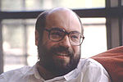
Mark Weiser vision of ubiquitous computing
Mark Weiser (1952 – 1999)
PhD (University of Michigan), CTO at Xerox PARC
Considered “Father” of ubiquitous computing
He is a highly influential figure in the area

Slide 13
Mark Weiser vision of ubiquitous computing
“Ubiquitous computing names the third wave in computing, just now beginning. First were mainframes, each shared by lots of people. Now we are in the personal computing era, person and machine staring uneasily at each other across the desktop. Next comes ubiquitous computing, or the age of calm technology, when technology recedes into the background of our lives.”

Slide 14
Mark Weiser vision of ubiquitous computing
“The most profound technologies are those that disappear”
”Products…that do not require active attention”
“Whenever people learn something sufficiently well, they cease to be aware of it”
“[Computers will become invisible and] people will simply use them unconsciously to accomplish everyday tasks”
“[R]ather than being a tool through which we work, and thus disappearing from our awareness, the computer too often remains the focus of attention”
“Applications are of course the whole point of ubiquitous computing”

Slide 15
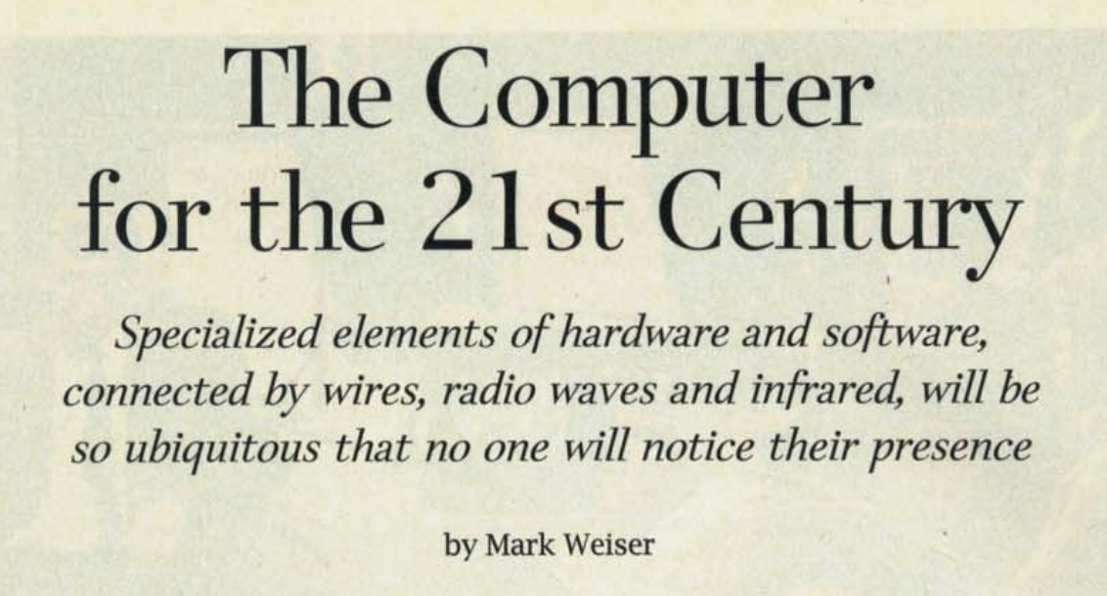
Mark Weiser vision of ubiquitous computing
The Computer for the 21st Century, Scientific American, 1991

Slide 16
Mark Weiser vision of ubiquitous computing
Hypothesis of the article: Advances in technology (low power, new wireless communication, new interfaces) will enable “invisible computing”, which will enhance human capability …

Slide 17
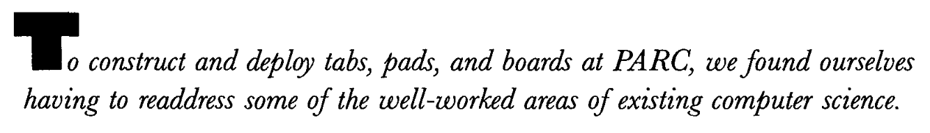
Mark Weiser vision of ubiquitous computing

Slide 18
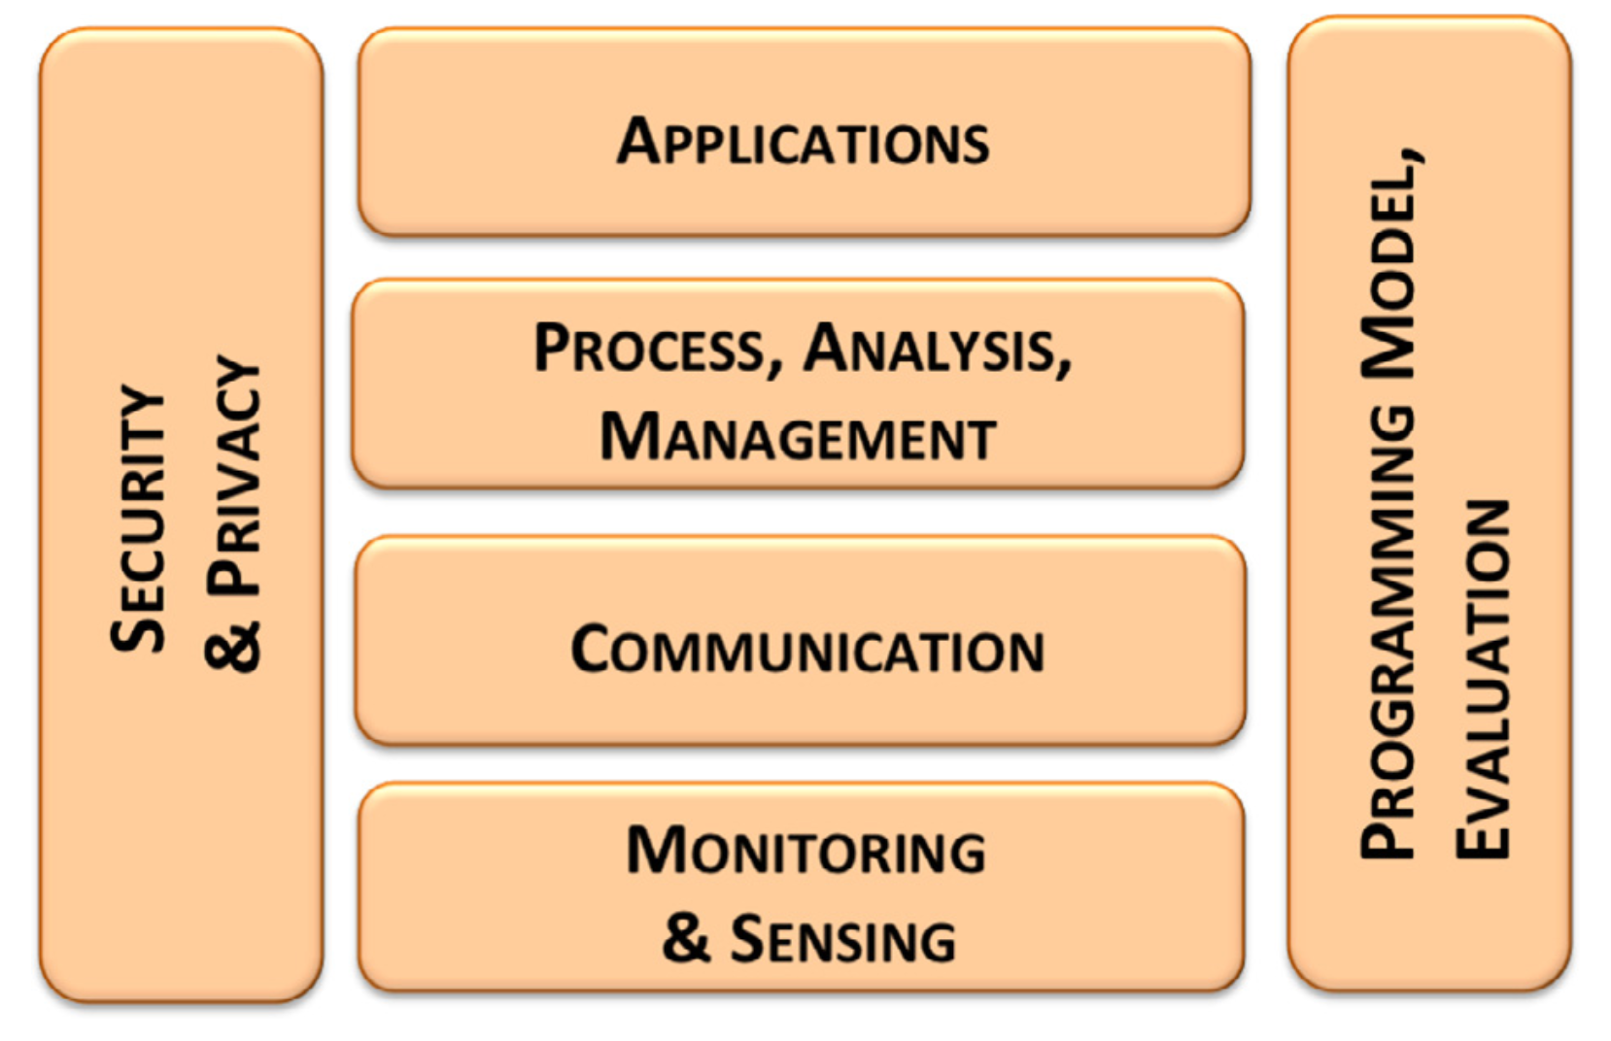
IoT covers a host of topics in computer sciences

Slide 19
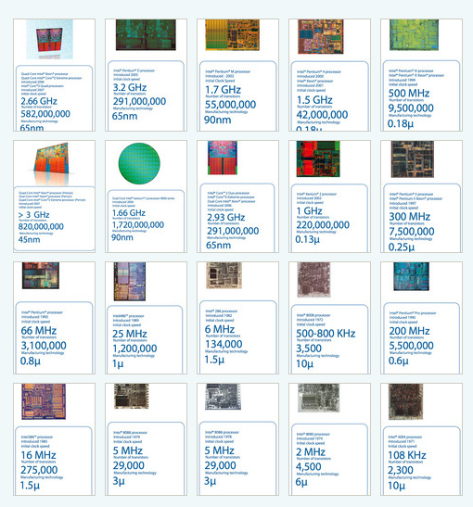
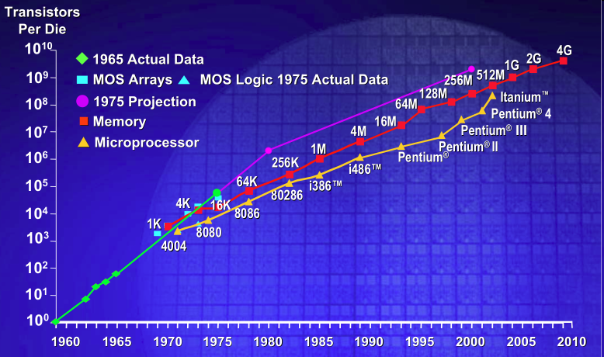
IC transistor count doubles every two years
Photo Credit: Intel
Notes:
So if we look at the computing spectrum today, each of the classes exist simultaneously. In a room we can put 100s of teraflops and many petabytes of computing.
Our productivity, document preparation, and personal information management fits in our pocket and a new class is emerging that will provide a means of streaming information to and from the physical world like we have never seen before.

Slide 20
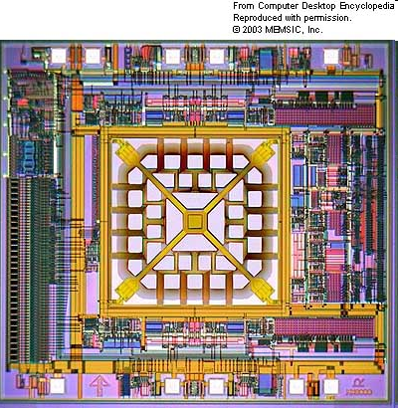
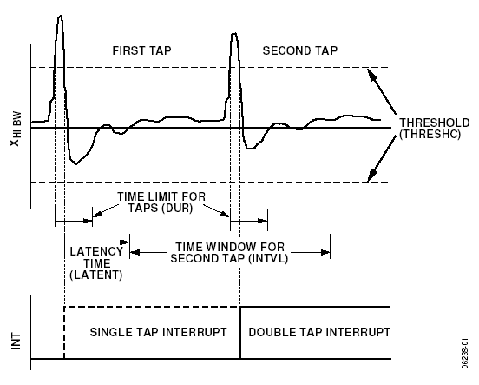
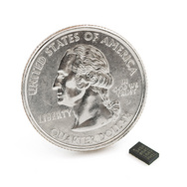
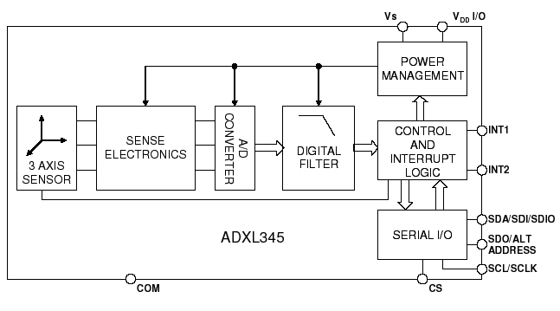
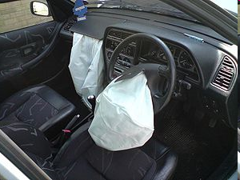
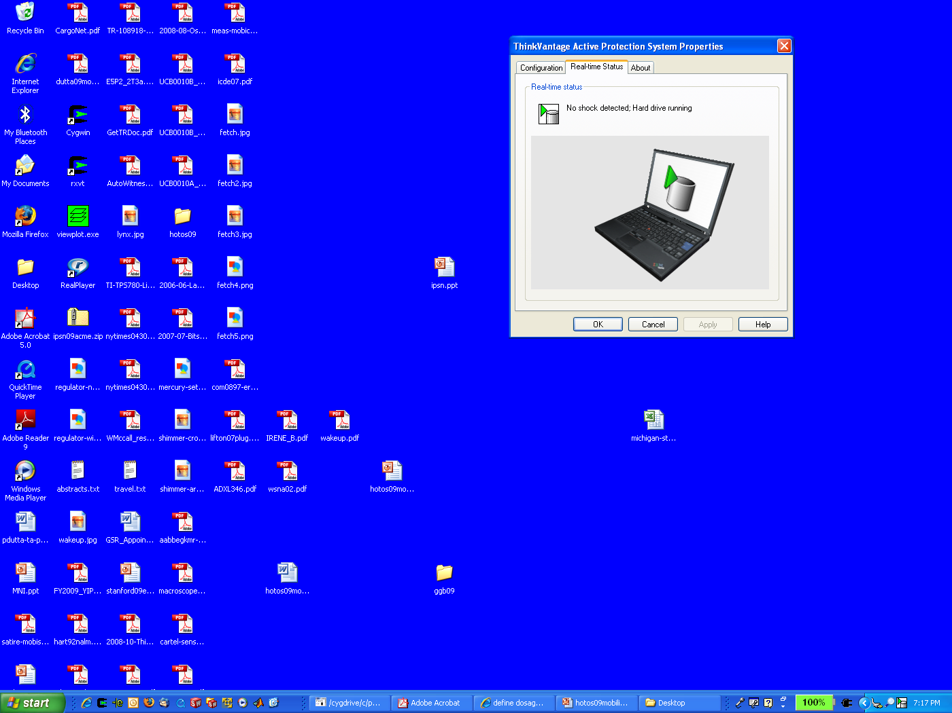
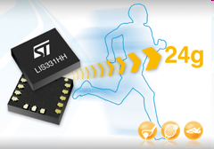
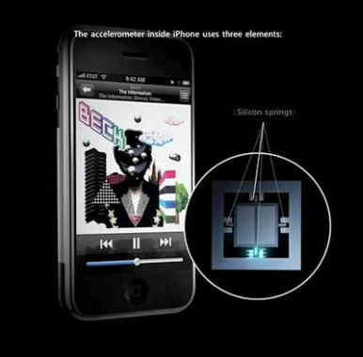
MEMS Accelerometers: Rapidly falling price and power
O(mA)
Price
Power
25 µA @ 25 Hz
ADXL345
[Analog Devices, 2009]
10 µA @ 10 Hz @ 6 bits
[ST Microelectronics, annc. 2009]

Slide 21
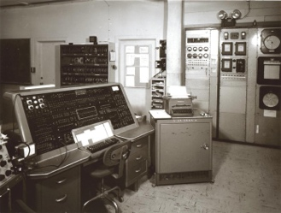
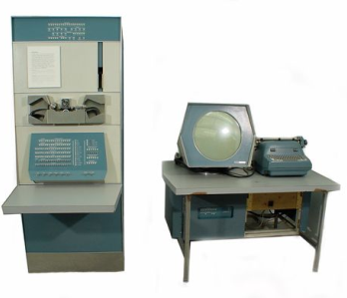
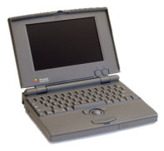
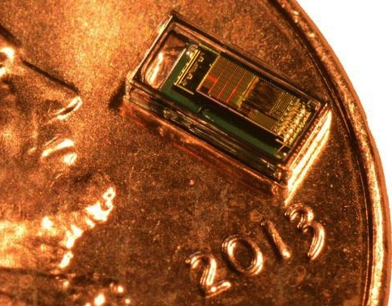
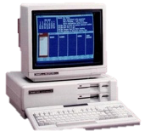

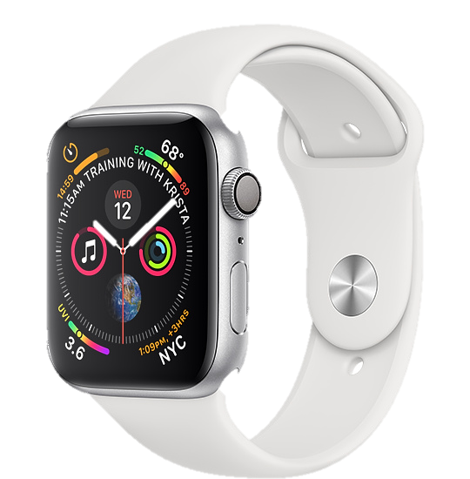
Trillion embedded devices will be deployed soon
“Roughly every decade a new, lower priced computer class forms based on a new programming platform, network, and interface resulting in new usage and the establishment of a new industry.”
Mainframe
1 per Enterprise
Workstation
1 per Engineer
[Bell et al. Computer, 1972, ACM, 2008]
Smart Dust
Laptop
100 – 1000’s per person
log (people per computer)
1 per Professional
IoT/Wearable
Mini Computer
10’s per person
1 per Company
Personal Computer
1 per Family
Smartphone
1 per person

Slide 22
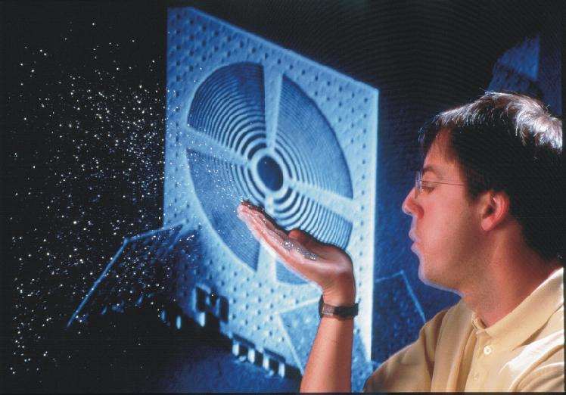
Smart dust
K. Pister, UC Berkeley, Smartdust

Slide 23
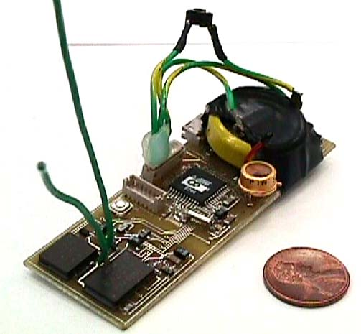
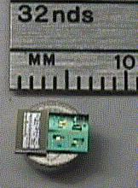
First generation of smart dust: Micro motes
1999
900 MHz radio
Magnetometer
Accelerometer
Light
Temperature
Pressure
One week lifetime in continuous operation,
2 years w/ 1% duty cycle
http://robotics.eecs.berkeley.edu/~pister/SmartDust/

Slide 24
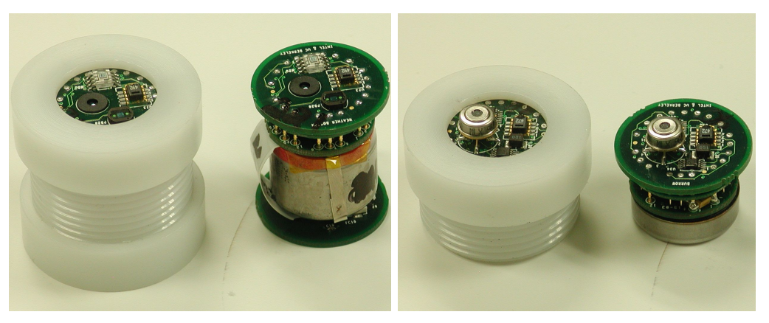
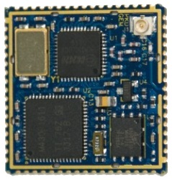
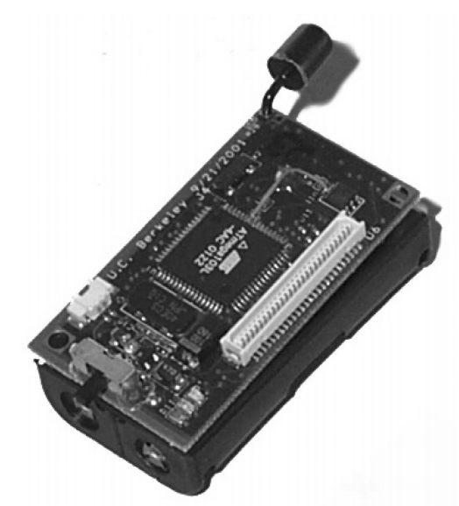
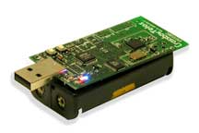
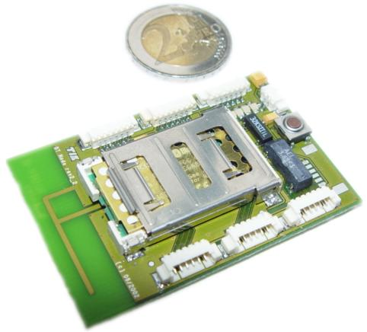
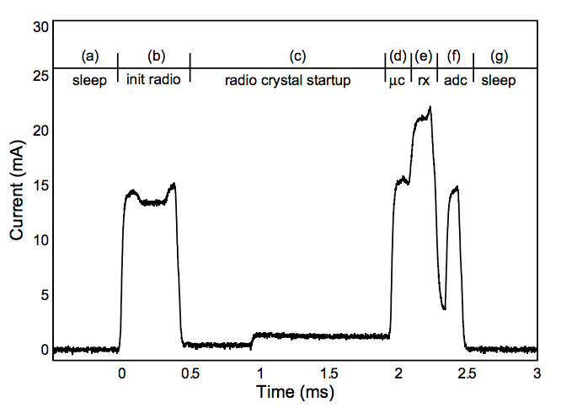
Wireless Sensor Networks (1998 –onwards)
CSP Workshop @ Xerox PARC
[soon to be IPSN]
Epic Core
(modular
platforms)
First MICA
Great Duck Island
TelosB
(Tmote Sky)
~2009
~1999
Workshop on Wireless Sensor Networks and Applications
[soon to be SenSys]
BTNode
Pister & Hollar’s
“Macro Motes”
B-MAC
Notes:
Collaborative Signal Processing Workshop (CSP Workshop)

Slide 25
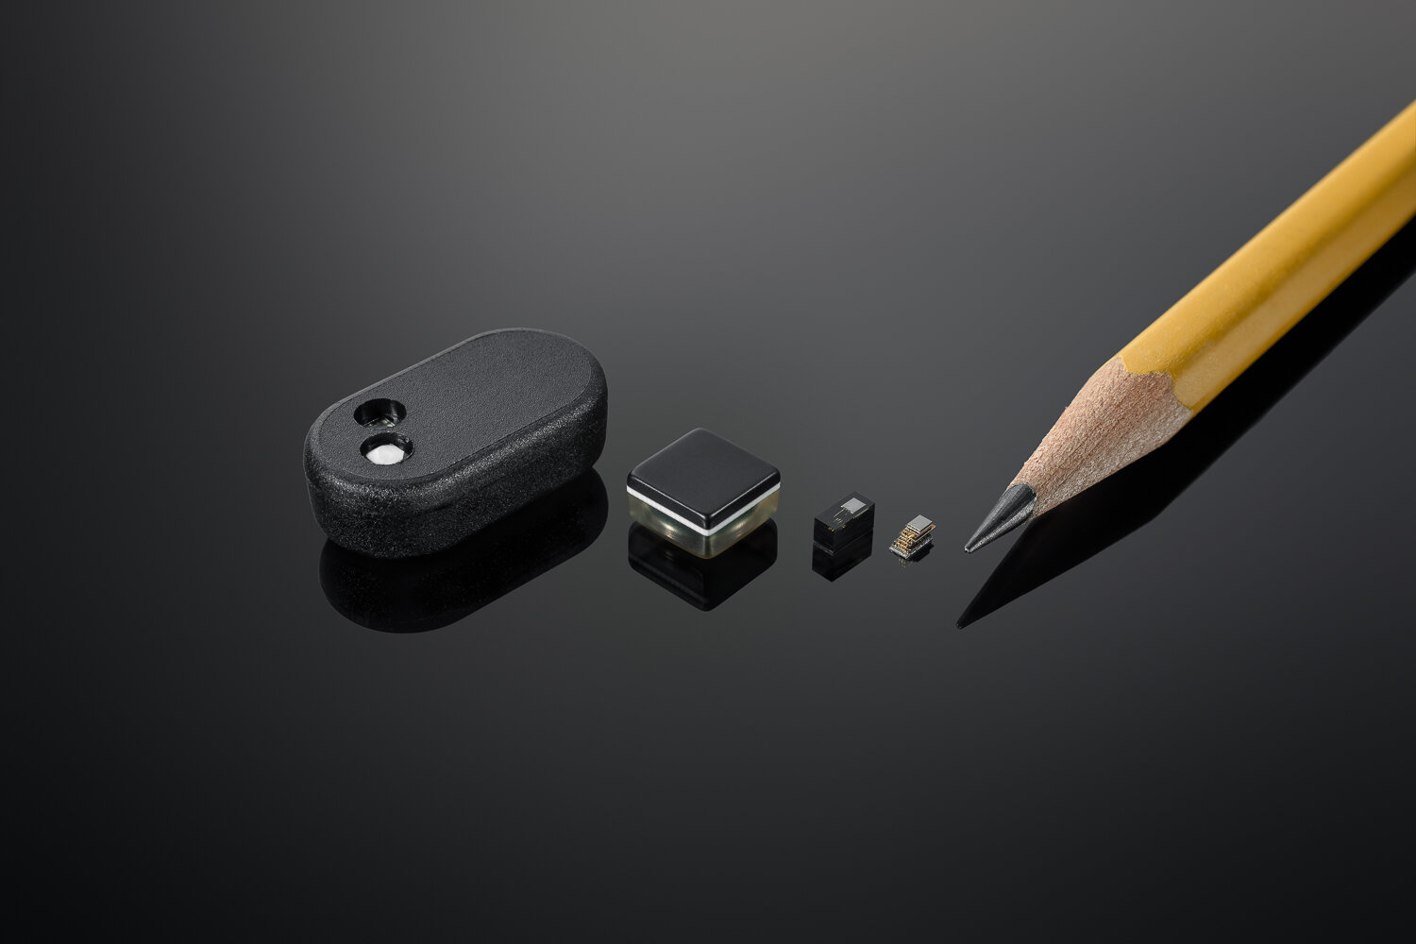
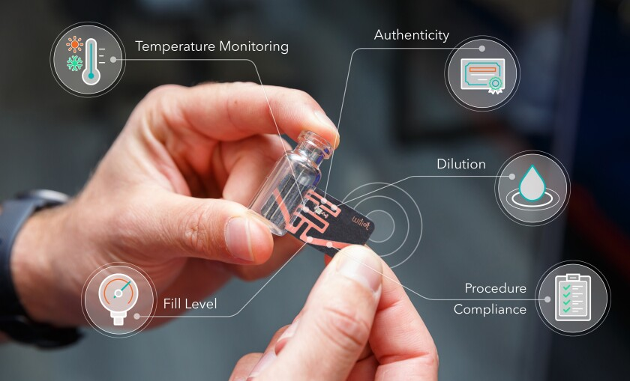
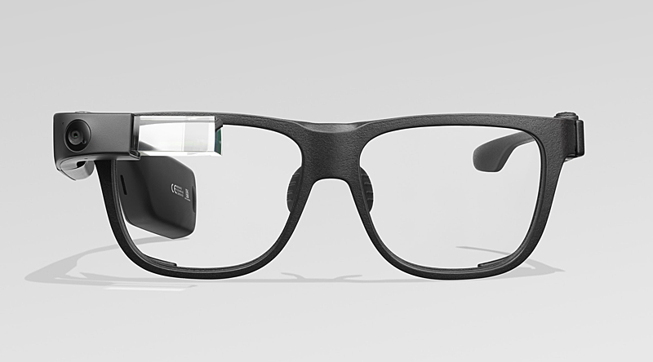
Where are we right now?

Slide 26
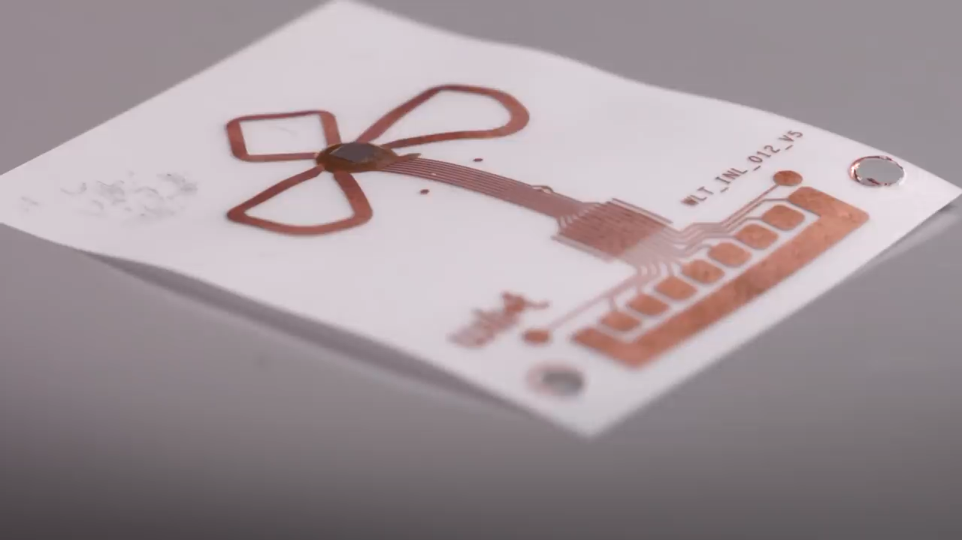
WilIoT: battery-free, bluetooth, stickers
Notes:
++ We may all have heard of the term Internet of Things. So how are these wireless embedded systems related to the Internet of Things: Today, IoT includes a broad class of devices, including powerful platforms such as smartphones. However, it also includes more resource-constrained devices and what we call Wireless Embedded Systems, and in fact, I consider it to be one of the essential parts of the IoT ecosystem.
++ These are platforms equipped with a radio transceiver, sensor, microcontroller, and some form of energy storage. These platforms also often form a network, and sensor network as it is called has been an active area of research for the past two decades.
++ The research community has also developed wireless embedded platforms which we may know about, and these include: CMUCAM, which is an image sensor platform developed at Carnegie Mellon University, or Permamote is long life sensor platform from the lab I am associated with at UC Berkeley or Lorea which is a long-range backscatter platform that I had developed as part of my doctoral dissertation at Uppsala University. All of these are an example of Wireless Embedded Systems.

Slide 27
Readings for next week: Vision paper
“The computer for 21st Century, Scientific American, 1991”
“Next Century Challenges: Mobile Networking for “Smart Dust” , ACM Mobicom 1999”
Notes:
++ We may all have heard of the term Internet of Things. So how are these wireless embedded systems related to the Internet of Things: Today, IoT includes a broad class of devices, including powerful platforms such as smartphones. However, it also includes more resource-constrained devices and what we call Wireless Embedded Systems, and in fact, I consider it to be one of the essential parts of the IoT ecosystem.
++ These are platforms equipped with a radio transceiver, sensor, microcontroller, and some form of energy storage. These platforms also often form a network, and sensor network as it is called has been an active area of research for the past two decades.
++ The research community has also developed wireless embedded platforms which we may know about, and these include: CMUCAM, which is an image sensor platform developed at Carnegie Mellon University, or Permamote is long life sensor platform from the lab I am associated with at UC Berkeley or Lorea which is a long-range backscatter platform that I had developed as part of my doctoral dissertation at Uppsala University. All of these are an example of Wireless Embedded Systems.

Slide 28
Roadmap of the presentation
Administrative and other information
Ubiquitous computing visions
Picking problems for the project?
Reading summary for submission
Notes:
Here is the roadmap of the major topics that I am going to cover during the presentation. We have already covered the exponential growth of the internet of things; next, I will talk about the critical energy challenge that can severely hinder this massive growth and preventing us from realising this immense economic value enabled by the IoT.

Slide 29
Course project discussion
Looking for ideas: Office hours, we can discuss projects
Working in team is okay with conditions
Can extend and adapt an existing research project
How to draft problem statement and select projects?
Examples
Exploring and designing databases for internet of things
Security of energy harvesting devices
Sensing using earphones

Slide 30
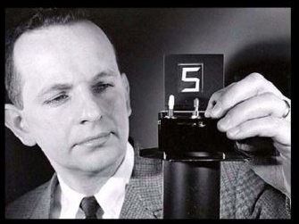
The Heilmeier Catechism
George H. Heilmeier
Director of DARPA, 1975-1977
Invented LCD displays
DARPA funds research projects
But which ones to take risks on?

Slide 31
The Heilmeier Catechism
What are you trying to do? Articulate your objectives using absolutely no jargon.
How is it done today, and what are the limits of current practice?
What is new in your approach and why do you think it will be successful?
Who cares? If you succeed, what difference will it make?
What are the risks?
How much will it cost?
How long will it take?
What are the mid-term and final “exams” to check for success?

Slide 32
Most importantly
“Applications are of course the whole point of ubiquitous computing”
Mark Weiser
“We need to increase the applications deployed to books written ratio in sensor networks”
Deborah Estrin
“In the future, increasing proportion of computer science research will be application-driven”
Eric Brewer and Mike Franklin

Slide 33
Roadmap of the presentation
Administrative and other information
Ubiquitous computing visions
Picking problems for the project?
Reading summary for submission
Notes:
Here is the roadmap of the major topics that I am going to cover during the presentation. We have already covered the exponential growth of the internet of things; next, I will talk about the critical energy challenge that can severely hinder this massive growth and preventing us from realising this immense economic value enabled by the IoT.

Slide 34
Next week?
We cover basics of wireless communication on IoT devices and platforms
Paper summary due to be submitted (end-of-week):
The computer for 21st Century, Scientific American, 1991
Next Century Challenges: Mobile Networking for “Smart Dust” , Mobicom 1999
Notes:
++ We may all have heard of the term Internet of Things. So how are these wireless embedded systems related to the Internet of Things: Today, IoT includes a broad class of devices, including powerful platforms such as smartphones. However, it also includes more resource-constrained devices and what we call Wireless Embedded Systems, and in fact, I consider it to be one of the essential parts of the IoT ecosystem.
++ These are platforms equipped with a radio transceiver, sensor, microcontroller, and some form of energy storage. These platforms also often form a network, and sensor network as it is called has been an active area of research for the past two decades.
++ The research community has also developed wireless embedded platforms which we may know about, and these include: CMUCAM, which is an image sensor platform developed at Carnegie Mellon University, or Permamote is long life sensor platform from the lab I am associated with at UC Berkeley or Lorea which is a long-range backscatter platform that I had developed as part of my doctoral dissertation at Uppsala University. All of these are an example of Wireless Embedded Systems.

Slide 35
CS 6204 - Advanced Topics in Networking
Ambuj Varshney
ambujv@nus.edu.sg
http://ambuj.se
Notes:
Good morning/afternoon everyone. Thank you for inviting me for giving this talk.
In this talk, I will describe my effort to design ubiquitous Internet of Things systems.
In the end of the talk: I will cover some of the future research directions that I would like to address as a faculty member.

